Slide 1
Network analysis
Marziyeh Mousavi
Introduction to datascience
Fall 2024

Slide 2
What is a Network?
A network refers to a structure representing a group of objects/people and relationships between them. It is also known as a graph in mathematics. A network structure consists of nodes and edges. Here, nodes represent objects we are going to analyze while edges represent the relationships between those objects.

Slide 3
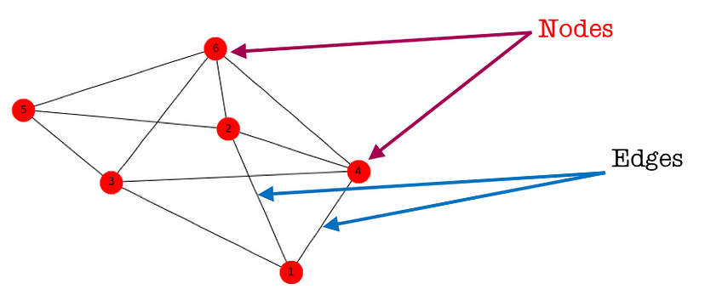
What is a Network?
For example, if we are studying a social relationship between Facebook users, nodes are target users and edges are relationships such as friendships between users or group memberships. In Twitter, edges can be following/follower relationships.

Slide 4
Why Network Analysis?
Network Analysis is useful in many living application tasks. It helps us in deep understanding the structure of a relationship in social networks, a structure or process of change in natural phenomenons, or even the analysis of biological systems of organisms.

Slide 5
Why Network Analysis?
Again, let’s use the network of social media users as an example. Analyzing this network helps in:
Identifying the most influent person/people in a group
Defining characteristics of groups of users
Prediction of suitable items for users
Identifying CM targets ,etc.
Friend Suggestion function in Facebook or Follow Suggestion function in Twitter.

Slide 6
Who is the Important Person?
A crucial application of network analysis is identifying the important node in a network. This task is called Measuring Network Centrality. In social network analysis, it can refer to the task of identifying the most influential member, or the representative of the group.

Slide 7
Who is the Important Person?
to define the most important node, we need a specific definition of the Important Node. There are several indicators used to measure the centrality of a node:
Degree centrality
Closeness centrality
Betweenness centrality
Eigenvector centrality

Slide 8
Degree centrality
Degree centrality is the simplest centrality measure to compute. Recall that a node’s degree is simply a count of how many social connections (i.e., edges) it has. The degree centrality for a node is simply its degree. A node with 10 social connections would have a degree centrality of 10. A node with 1 edge would have a degree centrality of 1

Slide 9
Degree centrality
For degree centrality, higher values mean that the node is more central. As mentioned before, each centrality measure indicates a different type of importance. Degree centrality shows how many connections a person has. They may be connected to lots of people at the heart of the network, but they might also be far off on the edge of the network.

Slide 10
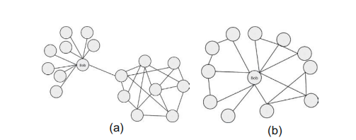
Degree centrality
For example, in Figure both nodes labeled “Bob” have the same high degree (i.e., lots of social connections, 9 in this case), but the two roles they play are very different. The one on the right is very central and the one on the left is peripheral. These show that while degree centrality accurately tells us who has a lot of social connections, it does not necessarily show who is in the “middle” of the network.

Slide 11
Closeness Centrality
Closeness centrality looks for the node that is closest to all other nodes. Recall that a path is a series of steps that go from one node to another. Closeness centrality for a node is the average length of all the shortest paths from that one node to every other node in the network.

Slide 12
Closeness Centrality
Closeness centrality corresponds the closest to what we see visually. Nodes that are very central by this measure tend to appear in the middle of a network. A node with strong closeness centrality also tends to be close to most people. In an investigation, that means the person will be in a good position to hear from most friends of friends. They will be a good source of secondhand information since it can reach them quite easily.

Slide 13
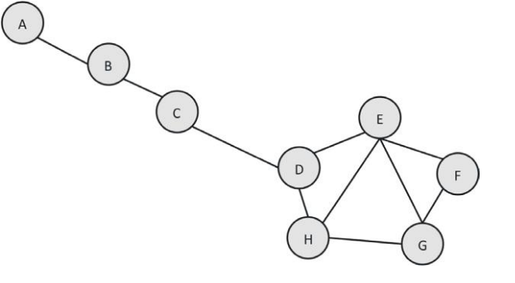
Closeness Centrality-Example
Let us determine the closeness centrality for node D and for node A. Start by computing the average shortest path length of node D.

Slide 14
Closeness Centrality-Example
Let us determine the closeness centrality for node D and for node A. Start by computing the average shortest path length of node D.

Slide 15
Closeness Centrality-Example
Next, we need the distance from D to every other node in the network. It has a distance of 1 to each of its direct friends: C, E, and H.

Slide 16
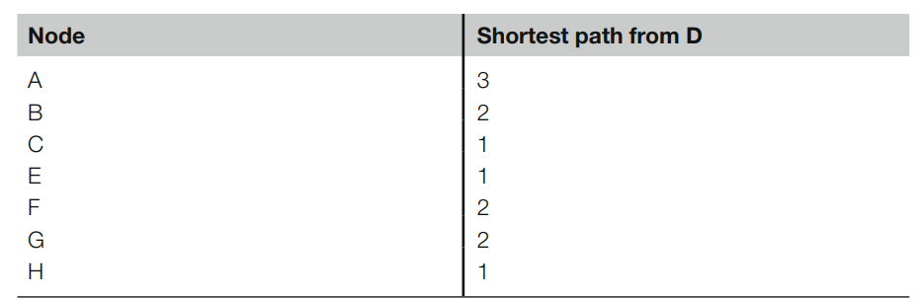
Closeness Centrality-Example
The following table shows all of the shortest path lengths for D:

Slide 17

Closeness Centrality-Example
The average of those shortest path lengths is:

Slide 18
Closeness Centrality-Example
We divide it by 7 because there are 7 other nodes. Thus, the closeness centrality for node D is 1.71.

Slide 19
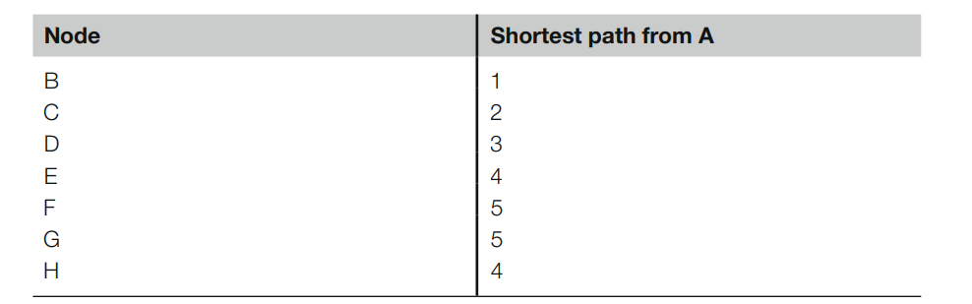
Closeness Centrality-Example
We do the same process for node A. The table below has all the shortest path lengths.

Slide 20

Closeness Centrality-Example
Here, the average shortest path length is:

Slide 21
Closeness Centrality-Example
Here, the average shortest path length is:

Slide 22
Closeness Centrality-Example
Thus, node A's closeness centrality is 3.43

Slide 23
Closeness Centrality-Example
In the case of closeness centrality—unlike with degree centrality—smaller values mean that the node is more central, because it means that it takes fewer steps to get to other nodes. So, since D's value of 1.71 is smaller than A's value of 3.43, D is more central

Slide 24
Betweenness Centrality
Betweenness centrality is a widely used measure that captures a person's role in allowing information to pass from one part of the network to the other.

Slide 25
Betweenness Centrality
consider Bob in Figure. He is the critical mode that allows information to pass from the cluster on the right to all the individual people he knows that were shown on the left. All information passing to and from those notes on the left must go through Bob if it is going to reach anyone else.

Slide 26
Betweenness Centrality
Thus, Bob is very important to the flow of information through this network. This is what betweenness centrality captures. Technically, it measures the percentage of shortest paths that must go through the specific node. The important thing to know is that betweenness is a measure of how important the node is to the flow of information through a network.

Slide 27
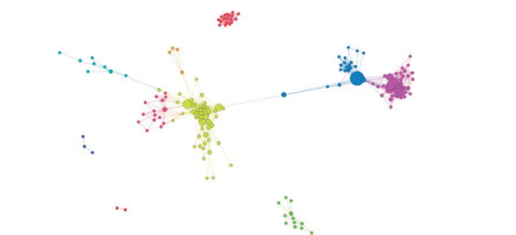
Betweenness Centrality
In an investigation, a node with high betweenness is likely to be aware of what is going on in multiple social circles. For example, in Figure, the large blue node in the upper right connects the blue group to the purple group. It is the only node that does so. Thus, talking to this large blue node with high betweenness is likely to yield insights about what both groups are doing and what is going on between those two groups.

Slide 28
Betweenness Centrality
In an investigation, a node with high betweenness is likely to be aware of what is going on in multiple social circles. For example, in Figure, the large blue node in the upper right connects the blue group to the purple group. It is the only node that does so. Thus, talking to this large blue node with high betweenness is likely to yield insights about what both groups are doing and what is going on between those two groups.

Slide 29
Betweenness Centrality
In an investigation, a node with high betweenness is likely to be aware of what is going on in multiple social circles. For example, in Figure, the large blue node in the upper right connects the blue group to the purple group. It is the only node that does so. Thus, talking to this large blue node with high betweenness is likely to yield insights about what both groups are doing and what is going on between those two groups.

Slide 30
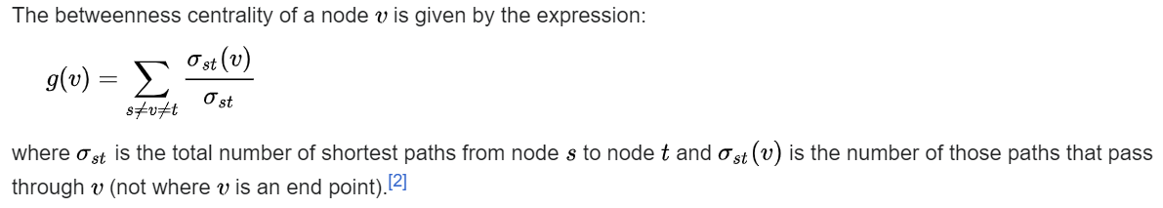
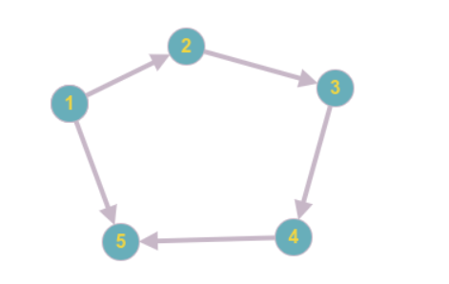
Betweenness Centrality-Example
Calculate betweenness centrality of node 2.

Slide 31
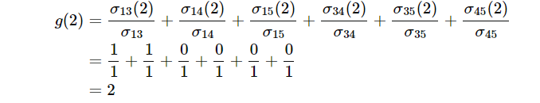
Betweenness Centrality-Example
Calculate betweenness centrality of node 2.

Slide 32
Eigenvector centrality
The final centrality measure is eigenvector centrality. It measures the influence that a node has in a network.
A node may have a low-degree centrality—and maybe even weak closeness centrality and betweenness centrality—but it can still be influential. Although a node that is central by one measure is often central by several other measures, this is not necessarily always the case

Slide 33
Eigenvector centrality
Recall that we have a network with a set of nodes N = {1, . . . , n} and adjacency matrix g = [gij] i,j∈N , where gij = 1 indicates a link from i to j, and gij = 0 indicates no such link. We want a measure of the importance of a node, whereby a node is important if other import nodes link to it

Slide 34

Eigenvector centrality
The simplest such measure is eigenvector centrality: a non-zero vector c = (ci)i∈N such that, for some scalar λ > 0, we have
That is, the centrality of each node i is proportional to the sum of the centrality of its neighbors

Slide 35
Eigenvector centrality
Note that in this definition we have gji rather than gij.
This doesn’t matter for undirected graphs. For directed graphs, it says that a node’s centrality derives from the centrality of nodes that point to it.
Interpretation: when “important”or “prestigous”nodes point to you, this makes you important/prestigious.
Equations still hold if we multiply c by a scalar. We typically normalize c so that ∑i∈N ci = 1.

Slide 36
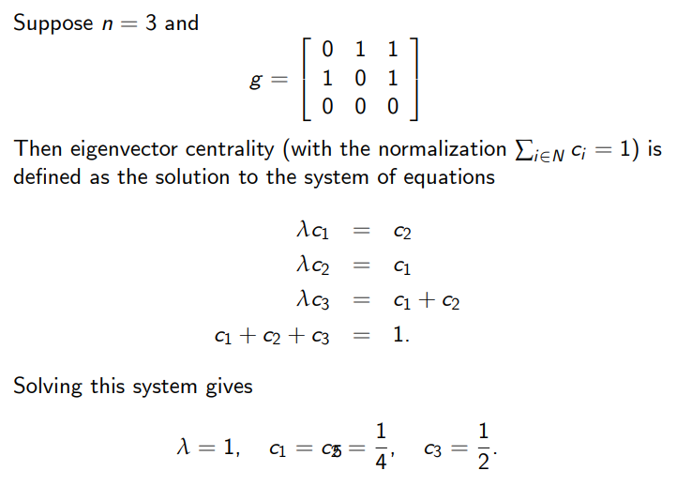
Eigenvector centrality-Example

Slide 37
Eigenvector centrality-applications
How Google ranks webpages (PageRank).
Which agents in a social network are influential in forming the group’s long-run consensus opinion (DeGroot learning).
Which firms in a production network are most systemically important (Leontief input-output analysis).

Slide 38
Implementation in python-networkx
NetworkX is a Python language software package for the creation, manipulation, and study of the structure, dynamics, and function of complex networks. It is used to study large complex networks represented in form of graphs with nodes and edges. Using networkx we can load and store complex networks. We can generate many types of random and classic networks, analyze network structure, build network models, design new network algorithms and draw networks.

Slide 39
Implementation in python-networkx
# Python program to create an undirected
# graph and add nodes and edges to a graph
# To import package
import networkx
# To create an empty undirected graph
G = networkx.Graph()

Slide 40
Implementation in python-networkx
# To add a node
G.add_node(1)
G.add_node(2)
G.add_node(3)
G.add_node(4)
G.add_node(7)
G.add_node(9)

Slide 41
Implementation in python-networkx
# To add an edge
# Note graph is undirected
# Hence order of nodes in edge doesn't matter
G.add_edge(1,2)
G.add_edge(3,1)
G.add_edge(2,4)
G.add_edge(4,1)
G.add_edge(9,1)
G.add_edge(1,7)
G.add_edge(2,9)

Slide 42
Implementation in python-networkx
# To get all the nodes of a graph
node_list = G.nodes()
# To get all the edges of a graph
edge_list = G.edges()

Slide 43
Implementation in python-networkx
# To remove a node of a graph
G.remove_node(3)
node_list = G.nodes()
# To remove an edge of a graph
G.remove_edge(1,2)
edge_list = G.edges()

Slide 44
Implementation in python-networkx
# To find number of nodes
n = G.number_of_nodes()
# To find number of edges
m = G.number_of_edges()

Slide 45
Implementation in python-networkx
# To find degree of a node
# d will store degree of node 2
d = G.degree(2)
# To find all the neighbor of a node
neighbor_list = G.neighbors(2)
#To delete all the nodes and edges
G.clear()

Slide 46
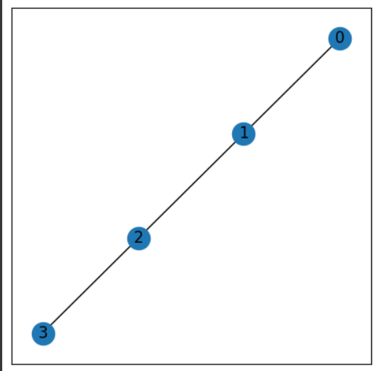
Implementation in python-centerality
import matplotlib.pyplot as plt
import networkx as nx
#create a path graph
G = nx.path_graph(4)
plt.figure(figsize =(5, 5))
nx.draw_networkx(G, with_labels = True)

Slide 47
Implementation in python-centerality
close_centrality= nx.closeness_centrality(G)
print(close_centrality)
#close_centrality is a dictionary which keys are the label of node and values are centrality

Slide 48
Implementation in python-centerality
deg_centrality= nx.degree_centrality(G)
print(deg_centrality)

Slide 49
Implementation in python-centrality
bet_centrality = nx.betweenness_centrality(G, normalized = True, endpoints = False)
print(bet_centrality)

Slide 50
Implementation in python-centrality
G = nx.path_graph(4)
centrality = nx.eigenvector_centrality(G)
sorted((v, f"{c:0.2f}") for v, c in centrality.items())

Slide 51
Page Rank and Directed Graph
PageRank (PR) is an algorithm used by Google Search to rank web pages in their search engine results. It is named after both the term "web page" and co-founder Larry Page. PageRank is a way of measuring the importance of website pages. According to Google:
PageRank works by counting the number and quality of links to a page to determine a rough estimate of how important the website is. The underlying assumption is that more important websites are likely to receive more links from other websites. Currently, PageRank is not the only algorithm used by Google to order search results, but it is the first algorithm that was used by the company, and it is the best known

Slide 52
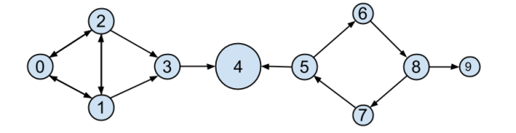
Page Rank algorithm-example
tech recruiters care very much which data scientists are respected by other data scientists. .In this model, we’ll track endorsements (source, target) that no longer represent a reciprocal relationship, but rather that source endorses target as an awesome data scientist .

Slide 53

Page Rank algorithm-example
We’ll need to account for this asymmetry:

Slide 54
Page Rank algorithm-example
However, “number of endorsements” is an easy metric to game. All you need to do is create phony accounts and have them endorse you. Or arrange with your friends to endorse each other. (As users 0, 1, and 2 seem to have done.)

Slide 55
Page Rank algorithm-example
A better metric would take into account who endorses you. Endorsements from people who have a lot of endorsements should somehow count more than endorsements from people with few endorsements. This is the essence of the PageRank algorithm, used by Google to rank websites based on which other websites link to them, which other websites link to those, and so on.

Slide 56
Page Rank algorithm-example
(If this sort of reminds you of the idea behind eigenvector centrality, it should.)
A simplified version looks like this:
1. There is a total of 1.0 (or 100%) PageRank in the network.
2. Initially this PageRank is equally distributed among nodes.
3. At each step, a large fraction of each node’s PageRank is
distributed evenly among its outgoing links.
4. At each step, the remainder of each node’s PageRank is
distributed evenly among all nodes.

Slide 57
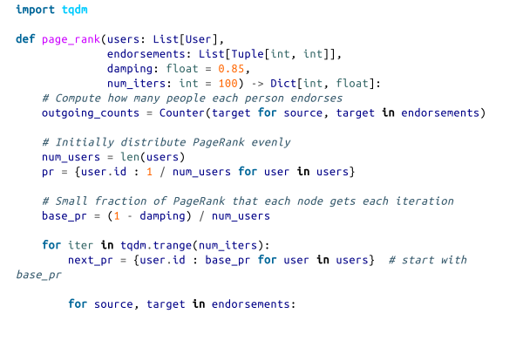
Page Rank algorithm

Slide 58
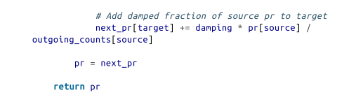
Page Rank algorithm
Even though 4 has fewer endorsements (two) than users 0, 1, and 2, his
endorsements carry with them rank from their endorsements. Additionally,
both of his endorsers endorsed only him, which means that he doesn’t have
to divide their rank with anyone else.

Slide 59
Implementation in python
import networkx as nx
G=nx.barabasi_albert_graph(60,41)
pr=nx.pagerank(G,0.4)
pr
#barabasi_albert_graph(n, m, seed=None, initial_graph=None):Returns a random graph using Barabási–Albert preferential attachmentA graph of nodes is grown by attaching new nodes each with edges that are preferentially attached to existing nodes with high degree.

Slide 60
Implementation in python
Output:
{0: 0.012774147598875784, 1: 0.013359655345577266, 2: 0.013157355731377924, 3: 0.012142198569313045, 4: 0.013160014506830858, 5: 0.012973342862730735, 6: 0.012166706783753325, 7: 0.011985935451513014, 8: 0.012973502696061718, ….}

